Slide 1

REAL ESTATE SALES IN CONNECTICUT FROM 2001-2020
VISHAL ORSU

Slide 2
Dataset and Research Questions
WHY THIS DATASET?
RESEARCH QUESTIONS
How have real estate sales volumes and prices changed over time, and are there any discernible patterns or trends?
What are the most common types of properties sold, and how do their prices compare across different locations and time periods?
Are there any significant differences in real estate sales patterns between different regions or cities?

Slide 3





METHODS:
DATA.GOV
CSV
R STUDIO
Python
SQL

Slide 4
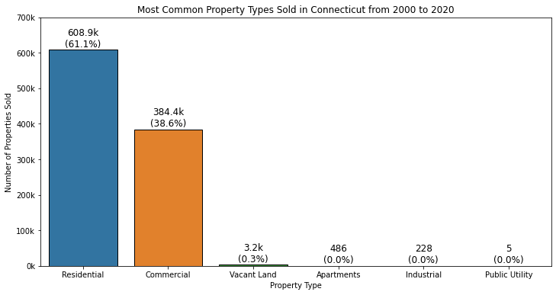
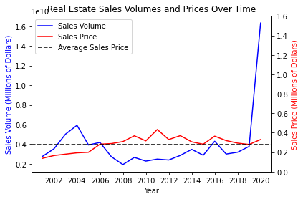
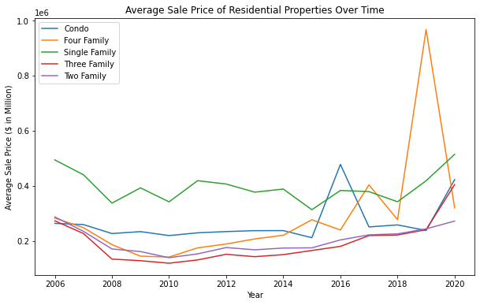
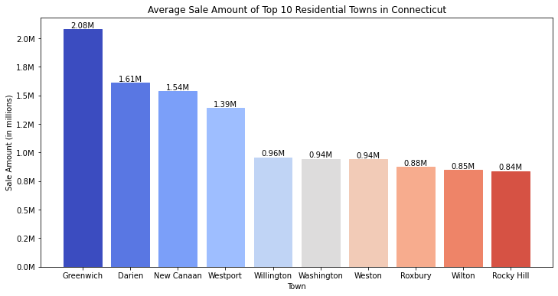
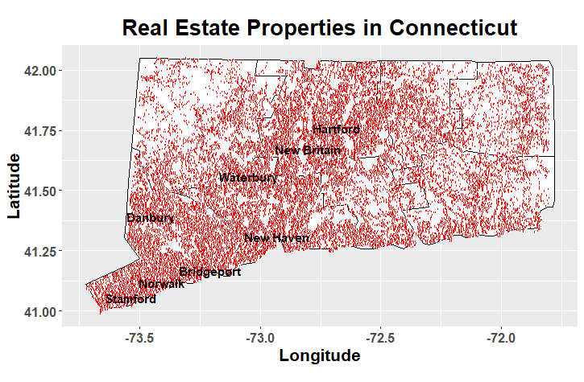
FINDINGS

Slide 5
LESSONS LEARNED
Importance of Data Cleaning
Value of Data Visualizations
Performing in Multiple Programming Languages
[1] Real estate sales 2001-2020 GL (2022) Catalog. Publisher data.ct.gov. Available at: https://catalog.data.gov/dataset/real-estate-sales-2001-2018 (Accessed: May 4, 2023).
DATASET REFERENCE

